Slide 1
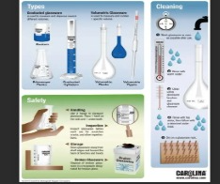
Basic Laboratory Terms
Medical Laboratory Technology
Applied English Course
Sharfina maulidayanti, M.Si

Slide 2
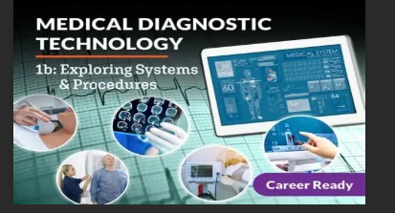

introduction
Laboratory is an essential part of medical diagnosis
Understanding basic terms helps communication
English is widely used in laboratory settings

Slide 3
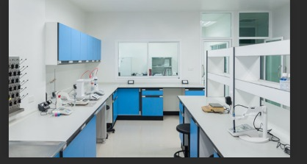
laboratory
Laboratory (Lab): A place where scientific tests are conducted
Used for research, diagnosis, and experiments

Slide 4
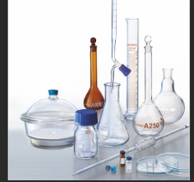

Equipment (Alat)
Beaker: Container for mixing liquids
Test Tube: Used for holding small samples
Microscope: Tool to see microscopic objects
Pipette: Used to transfer small volumes of liquid

Slide 5
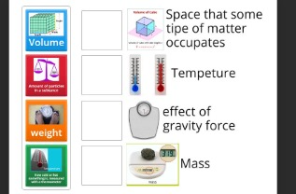
Measurement Terms
Volume: Amount of liquid (mL, L)
Mass: Weight of a substance (g, mg) Temperature: Heat level (°C)
Concentration: Amount of substance in solution

Slide 6
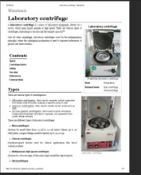
Laboratory Procedures
Centrifugation: Separating substances by spinning
Incubation: Keeping samples at a specific temperature
Sterilization: Removing all microorganisms

Slide 7
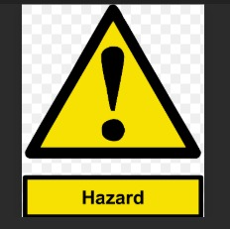

Safety Terms
Hazard: Potential danger
Protective Equipment (PPE): Gloves, mask, lab coat
Contamination: Unwanted substances in samples

Slide 8
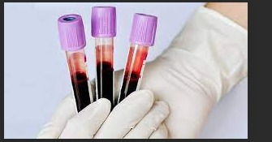
Biological Terms
Specimen: Sample from patient
Pathogen: Disease-causing organism
Cell: Basic unit of life
Bacteria: Microscopic organisms

Slide 9
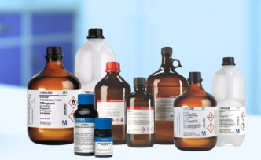
Chemical Terms
Reagent: Chemical used in tests
Solution: Mixture of substances
Acid: Substance with low pH
Base: Substance with high pH

Slide 10
Common Verbs in Laboratory
Measure: To determine size/amount
Mix: Combine substances
Observe: Watch carefully
Record: Write down results

Slide 11
Importance of English in Lab
Helps reading manuals and journals
Supports international communication
Improves professionalism

